Slide 1
API Management
From Bad to Good

Slide 2

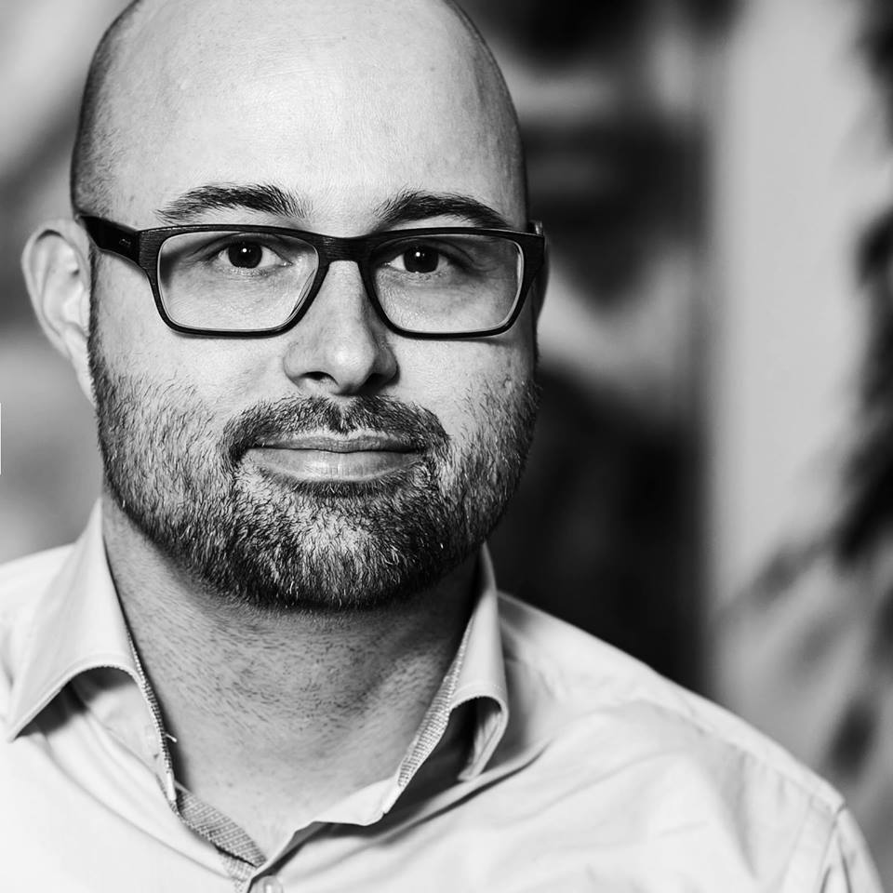




Über uns
Daniel Wagner
Anton Kalcik
daniel_wagn3r
akalcik
kalcik.net

Slide 3
Integration Historisch
Simple login (forms and cookies)
Single Sign-On
Mobile apps
Delegated authorization

